Slide 1
AI-Powered Hospital Management System
Healthcare Automation using n8n, Gemini AI & Supabase
By: Geetika Boddapati

Slide 2
Problem Statement
Hospitals still rely on several manual processes that lead to delays, inefficiencies, and increased administrative workload.
Problems Identified
Manual patient registration
Time-consuming appointment scheduling
Delayed medical report analysis
Manual doctor approvals
Billing errors and repetitive calculations
Missed medication reminders
Lack of centralized patient records
Poor communication between departments
Need
An intelligent workflow automation system that assists healthcare professionals while maintaining human oversight.

Slide 3
Project Objectives : This project aims to automate repetitive hospital operations while improving efficiency and patient care.
Automate patient registration and appointments
1
Generate AI-assisted preliminary medical analysis
2
Support doctors with clinical recommendations
3
Enable human approval before treatment
4
Automate hospital billing
5
Send automated email notifications
6
Improve patient engagement through reminders
7
Maintain centralized digital records
8

Slide 4
System Architecture
Frontend: Patient forms for registration, appointments, reports, billing, and approvals
n8n: Workflow orchestration engine
Gemini AI: Clinical analysis and decision support
Supabase: Centralized database for patient records and workflow data
Gmail API: Automated notifications to patients and doctors

Slide 5
Workflow Overview
Workflow 1 – Patient Registration:Registers patients, validates duplicates, generates unique Patient ID, and stores data in Supabase.
Workflow 2 – Appointment Booking:Books appointments using AI-assisted department prediction and doctor availability.
Workflow 3 – Medical Report Upload & AI Analysis:Extracts text from reports and generates a structured preliminary assessment using Gemini AI.
Workflow 4 – Doctor Approval System:Doctors review AI recommendations and approve or reject treatment.
Workflow 5 – Medication & Follow-up Reminder:Automatically sends medication reminders and follow-up notifications.
Workflow 6 – Billing & Analytics:Generates invoices, calculates GST, stores billing records, and emails invoices.

Slide 6
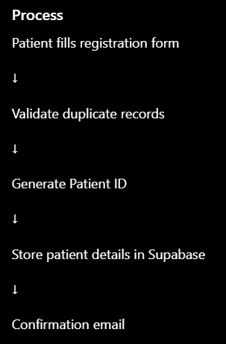
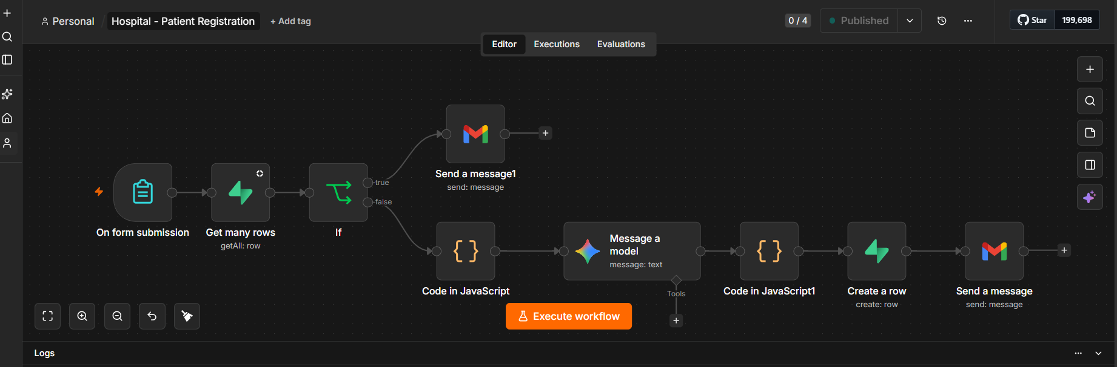
Workflow 1: Patient Registration
Digitize and automate patient onboarding.

Slide 7
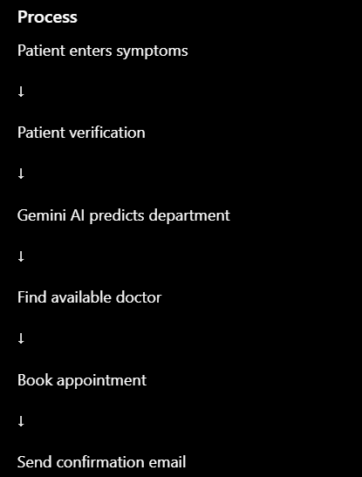
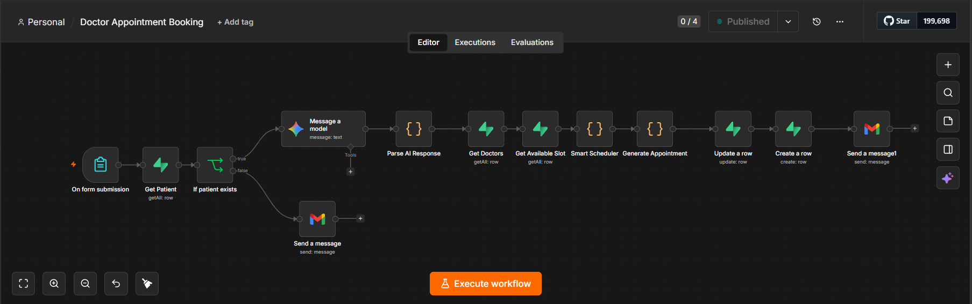
Workflow 2: Appointment Booking
Automate appointment scheduling with AI support.

Slide 8
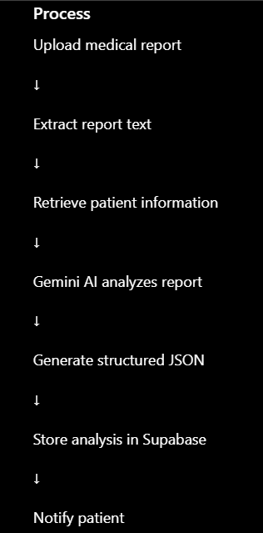
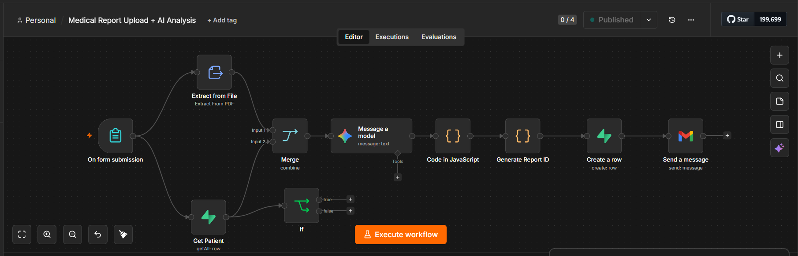
Workflow 3: Medical Report Upload & AI Analysis
Assist doctors by generating preliminary clinical insights.

Slide 9
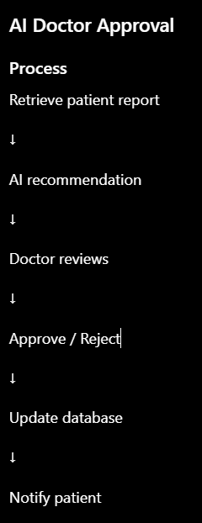
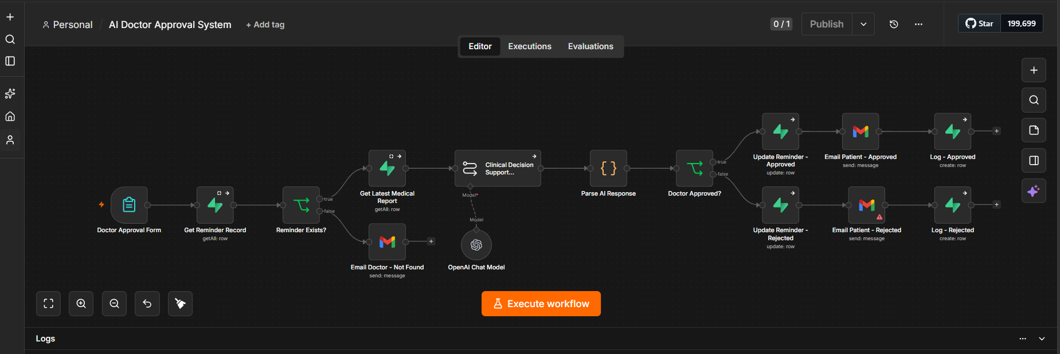
Workflow 4: AI Doctor Approval System

Slide 10
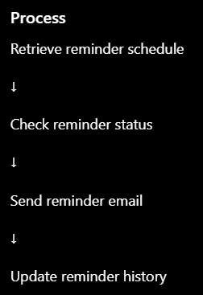
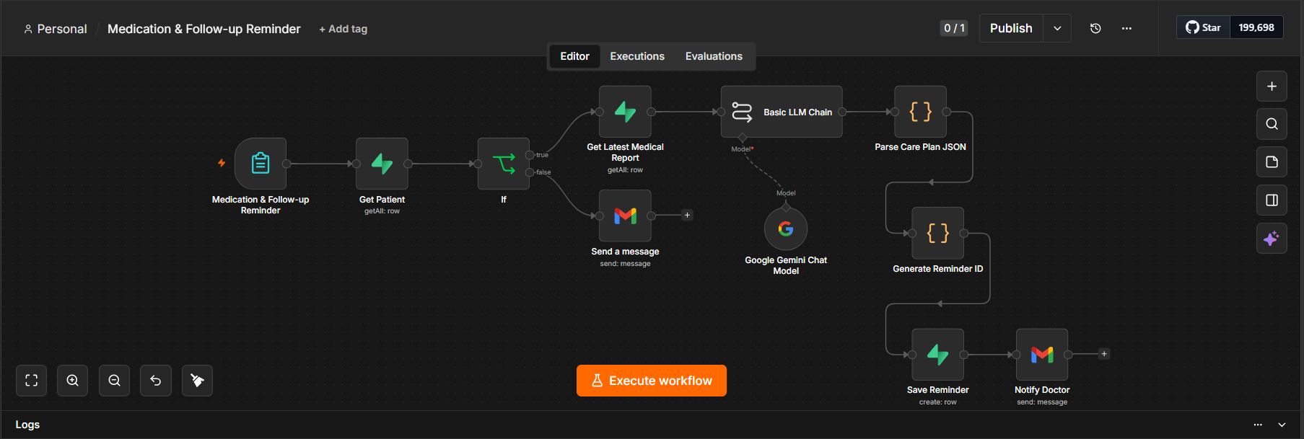
Workflow 5 :Medication & Follow-up Reminder

Slide 11
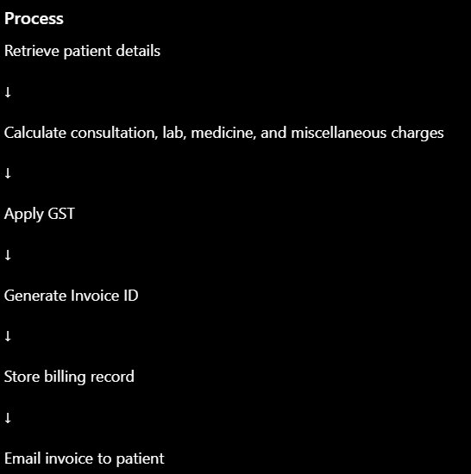
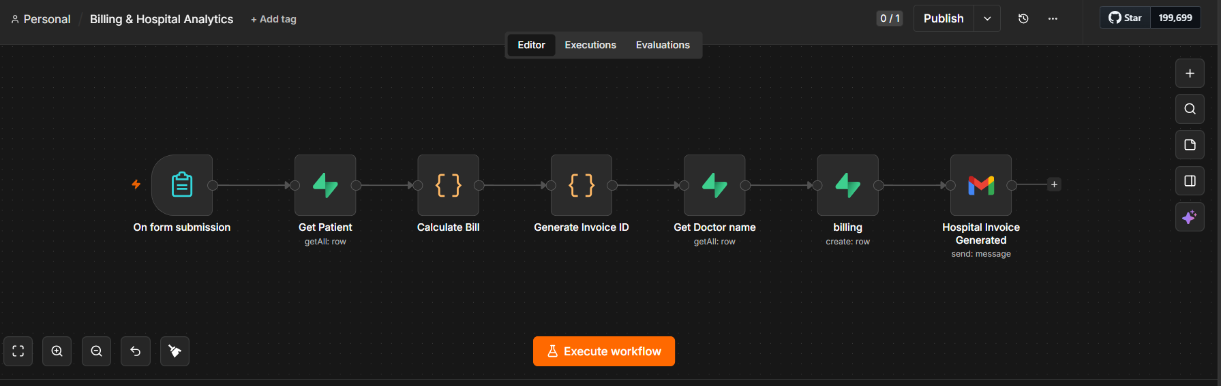
Workflow 6: Billing & Hospital Analytics
Automate billing after treatment approval.

Slide 12
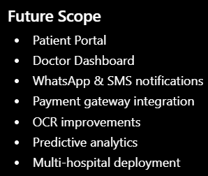
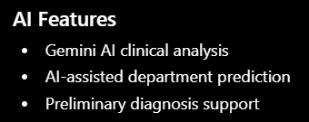
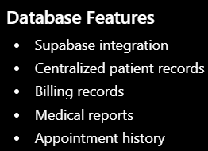
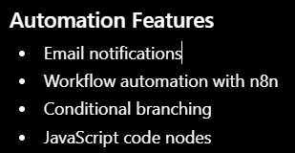

Advanced Features

Slide 13
Conclusion:
The AI-Powered Hospital Management System successfully demonstrates how workflow automation and artificial intelligence can improve hospital efficiency while ensuring that doctors remain the final decision-makers.
Key Benefits:-
Reduced manual work
Faster appointment scheduling
AI-assisted clinical support
Automated billing
Timely medication reminders
Improved patient experience
Centralized and secure data management
Scalable architecture for future enhancements

